Slide 1
Demand Forecasting Model Evaluation
Name: Dakolo Emmanuel Imomotimi
Learners ID: 239047016
Course Code: BAN 6800
Date: 18th May 2025

Slide 2
Business Overview
HealthyPact is a mid-sized retail company with multiple stores nationwide. The organization relies on analytics for demand forecasting, inventory planning, and marketing. However, HealthyPact have faced challenges with its recent model performance forecasting accuracy, prompting a review and redesign.
Notes:
HealthyPact is a mid-size retail company operating across multiple cities nationwide. They rely on analytics to support critical operations particularly demand forecasting, inventory and marketing strategy. However, in recent months the accuracy of their business models declined which as led to different missed opportunities within the company. As a result of these losses, the company has initiated a review to redesign the demand forecasting model.

Slide 3
Project Objective
The Objective of this project, is to develop an improved demand forecasting model using historical sales record, seasonality and economic indicators. The goal is to support optimal product pricing and strategic planning based on accurate projections.
Notes:
Our goal was to evaluate alternative models, identify key demand drivers, and implement a more reliable and interpretable forecasting solution.”

Slide 4
Project Methodology
For the success and effectiveness of the model two (2) forecasting models were developed and evaluated
Prophet: a time series model with external regressors ( CPI, campaigns, holidays)
XGBoost: a regression model using lag features and demand drivers.
The models were assessed using MAE, RMSE and MAPE via cross validation
MAE- Mean Absolute Error
RMSE: Root Mean Squared Error
MAPE: Mean Absolute Percentage Error
Notes:
MAE : Explanation: It calculates the average absolute difference between the actual values yi and predicted values y^​i​
Interpretation: Lower MAE means better model performance. It's in the same unit as the output variable.
RMSE
Explanation: It measures the square root of the average squared differences between actual and predicted values.
Interpretation: RMSE penalizes large errors more than MAE, making it sensitive to outliers. Also in the same unit as the output variable.
MAPE
Explanation: It expresses the prediction error as a percentage of the actual values.
Interpretation: Useful for comparing errors across different scales. However, it's undefined when yi=0y_i = 0yi​=0 and can be biased if actual values are close to zero.

Slide 5
Key Findings
Model Performance
Prophet demonstrated superior forecasting accuracy compared to XGBoost:
MAE: 128 (Prophet) vs. 196 (XGBoost)
RMSE: 144 (Prophet) vs. 223 (XGBoost)
Key Driver of Demand
Campaign activity emerged as the most significant influencer of product demand, highlighting the impact of marketing efforts.
Notes:
Model Performance :We evaluated Prophet and XGBoost using two standard regression metrics — Mean Absolute Error (MAE) and Root Mean Squared Error (RMSE). Prophet clearly outperformed XGBoost, with a significantly lower MAE of 128 compared to 196, and an RMSE of 144 versus 223. This indicates that Prophet’s predictions were not only more accurate on average but also had fewer large errors.”
Key Driver of demand: One of the most important insights from our feature analysis was that campaign activity had the strongest influence on demand. This aligns with expectations, as promotional campaigns typically drive customer attention and sales. It also reinforces the need for synchronized marketing and demand planning efforts

Slide 6
Key Findings
Forecast Reliability
Model forecasts were most reliable within 30 to 60-day horizons, suggesting optimal use for short- to medium-term planning.
Interpretability & Trends
Prophet’s ability to model seasonality and trend components provided enhanced interpretability and consistent performance across time
Notes:
3. Forecast Reliability: Our models produced the most accurate forecasts within a 30–60 day window. Beyond that, prediction uncertainty increased. This tells us that these models are best suited for short- to medium-term forecasting, making them highly valuable for agile decision-making in pricing and inventory management.
4. Interpretability & Trends: Lastly, Prophet’s strength in capturing seasonal trends and holidays made it not only accurate but also interpretable. This allowed us to clearly visualize and explain demand fluctuations over time — a major advantage for communicating insights with non-technical stakeholders

Slide 7
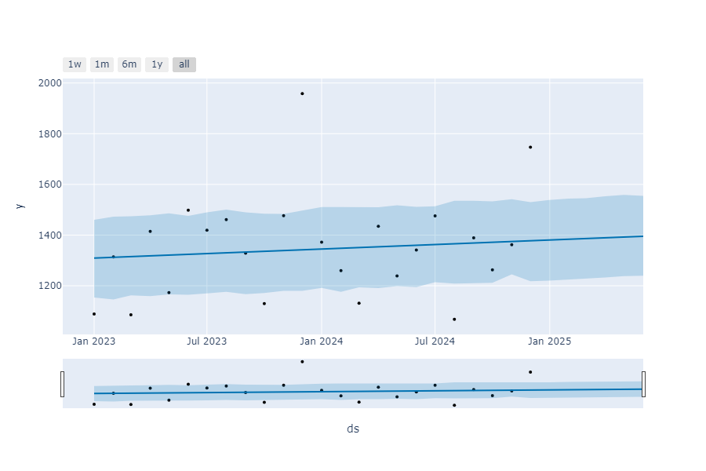
Updated Prophet Forecast Overview
Notes:
This updated Prophet forecast shows a stable upward trend in demand with consistent confidence intervals.
The actual sales data align well with the model’s expectations, making it suitable for mid-range planning
and strategic forecasting at HealthyPact.

Slide 8
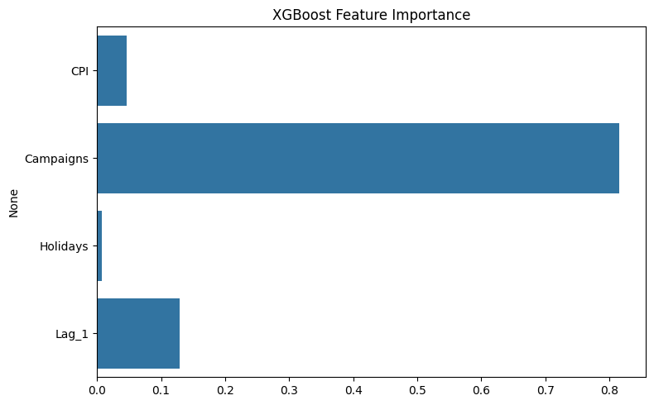
Prophet Forecast vs Actual
Notes:
Prophet aligns well with actuals, smoothing variability for better strategic use.

Slide 9
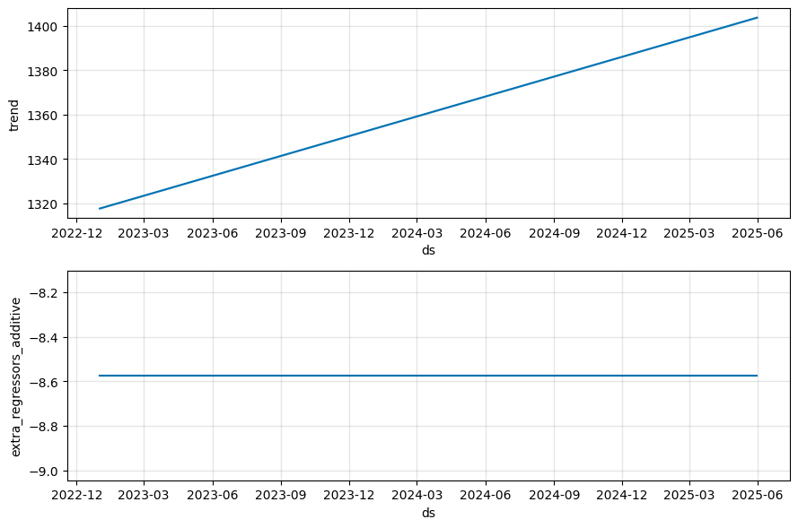
Prophet Forecast Overview
Notes:
The model predicts a gradual upward trend in demand. Most actual values fall within the confidence band,
indicating a well-calibrated model.

Slide 10
Prophet Trend & Regressors
Notes:
The trend shows steadily increasing demand. External regressors like CPI and Campaigns
contributed minimal variation during this period.

Slide 11
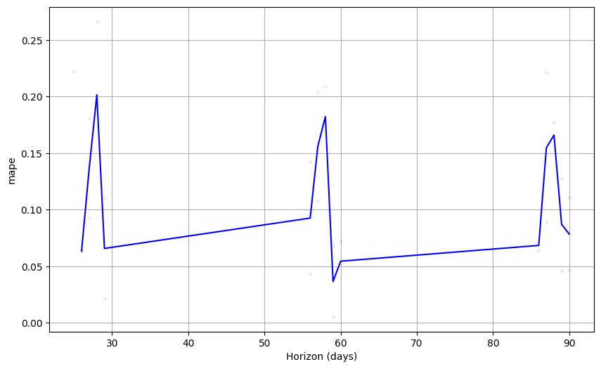
MAPE vs Forecast Horizon
Notes:
Short- to mid-term predictions (30–60 days) are most accurate. Higher horizons introduce volatility.

Slide 12
XGBoost: Actual vs Predicted
Notes:
XGBoost tracks the overall trend but underpredicts demand peaks.

Slide 13
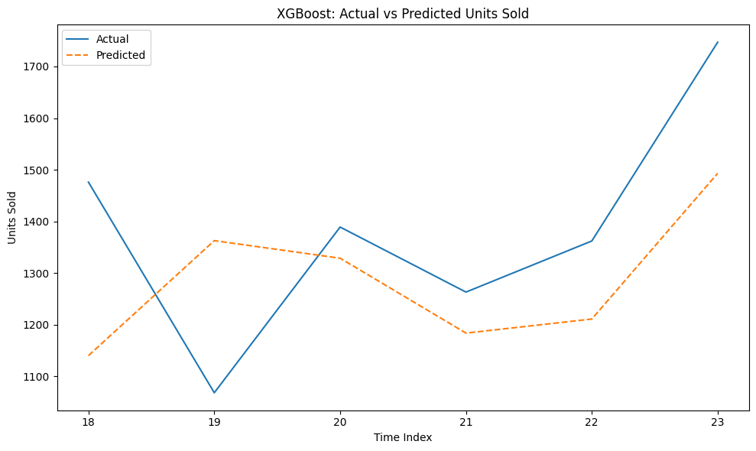
XGBoost Feature Importance
Notes:
Campaigns have the strongest influence on predictions, followed by lagged sales. CPI and Holidays are minimal.

Slide 14
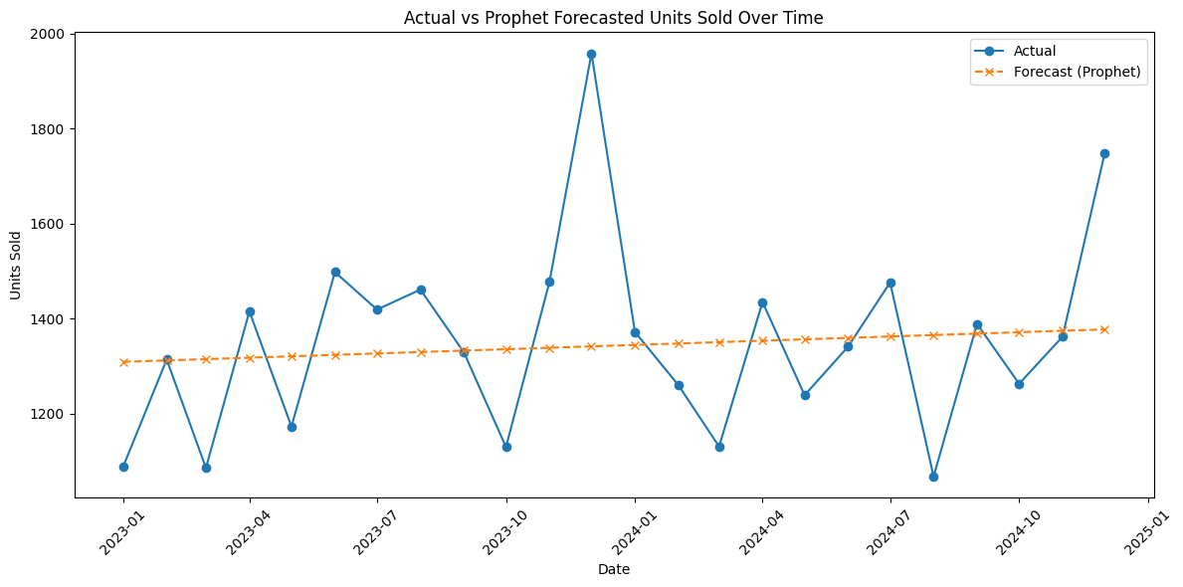
Final Comparison: Prophet
Notes:
Prophet provides reliable demand forecasts with strong trend alignment, ideal for HealthyPact’s planning needs.

Slide 15
Recommendations
Deploy Prophet as the core forecasting tool for HealthyPact.
Integrate campaign planning with demand projections.
Monitor CPI and seasonal holidays for improved model adjustments.
Extend model segmentation to individual stores or regions.
Notes:
1. Deploy Prophet as the Core Forecasting Tool
Our analysis shows that Prophet consistently outperformed XGBoost in both accuracy and interpretability. Therefore, we recommend adopting Prophet as the core engine for HealthyPact’s demand forecasting. Its ability to capture trends, seasonality, and holiday effects makes it a strong fit for retail operations.
2. Integrate Campaign Planning with Demand Projections
Since campaign activity was identified as the strongest demand driver, it’s crucial to tightly align marketing schedules with demand forecasts. This integration will allow for better anticipation of spikes in product interest and ensure appropriate inventory levels.
3. Monitor CPI and Seasonal Holidays for Model Refinement
External factors like the Consumer Price Index (CPI) and seasonal holidays were shown to impact demand. Regularly updating these variables in the forecasting model will help HealthyPact respond more dynamically to economic shifts and consumer behavior changes.
4. Extend Model Segmentation to Stores or Regions
Finally, we recommend segmenting forecasts by individual stores or regional clusters. This will allow for more granular insights and better local inventory management, especially since demand patterns can vary by geography.

